Slide 1
L05: Intro to GitHub
CSCI 185, Spring 2023 Intro to Computer Programming for the Web

Slide 2
Announcements
HW2 Posted. Due next Monday at midnight
Tutorial 3 (Friday): Make a homepage to showcase your work in this class.

Slide 3
Outline
Presentations
Intro to Git & GitHub
Activity: Configuring git and GitHub to work on your laptop

Slide 4
Outline
Presentations
Intro to Git & GitHub
Activity: Configuring git and GitHub to work on your laptop

Slide 5
Presentation Format
Groups of 3-4 (Sarah will assign them)
Up to 5 minutes to present, 2 minutes for questions
Listening is as important as presenting:
Please be an active listener. Devices off (unless you’re presenting). Think of a question or response that you have about the topic being presented.
Be prepared to share something you learned from another person’s presentation

Slide 6
Outline
Presentations
Intro to Git & GitHub
Activity: Configuring git and GitHub to work on your laptop

Slide 7
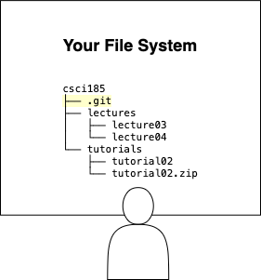
What is git?
Git is a software program that you install on your computer. Allows you to:
Track versions of your files
Easily send and receive files on another computer / the cloud

Slide 8
How do you use it?
Initialize a new git repository on your computer.
This creates a “hidden” .git folder, which git uses to track and store code changes.
Teach git which files you want it to track. This is called staging them
Commit your files when you’re ready to take a snapshot of them.
Once you have “committed” files to your repository, you can send these files easily to other computers using the push and pull commands..

Slide 9
Git command Cheat Sheet
Command | Purpose | Notes
git init | Initializes a repository | This creates a “hidden” .git folder. The git software track changes made to your files using data stored in this folder.
git add . | Stages all files in the folder | You have to stage your files (tell git which files you want to commit to version control). The period means “all files in the directory.” You can also stage specific files.
git commit -m "styled my navbar" | Commits changes | Committing changes means that a version of your code has been saved (“remembered” by files in the .git folder). Allows you to preview / restore old versions of your code.
git pull | Downloads code changes | Allows you to copy changes from a server to your computer. Useful if you are collaborating with others.
git push | Uploads code changes | Allows you to copy changes from your computer to a server. This is how we will publish our files to the Internet.

Slide 10
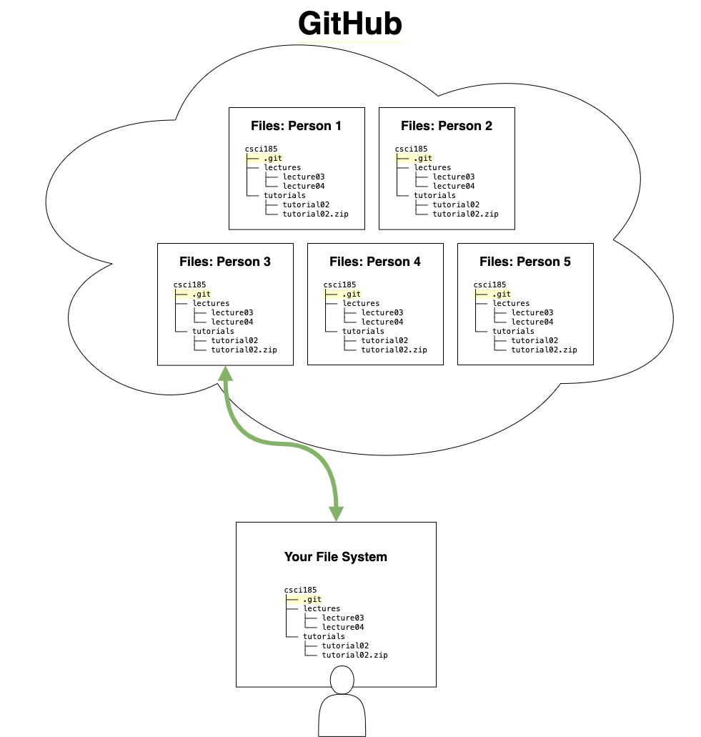
What is GitHub?
GitHub is a private company that uses git. Some of the services GitHub provides include:
Hosting git repositories for individuals and teams.
Allows coders to copy, edit, and share files to and from the GitHub server easily.
Makes source code more widely available for open source projects.
Provides various code deployment services, including providing some website hosting services.

Slide 11
Outline
Presentations
Intro to Git & GitHub
Activity: Configuring git and GitHub to work on your laptop

Slide 12
Today’s Activity
Today, you will be configuring git and GitHub so that you can publish your files to a public web server.
Activity Instructions

